Slide 1
NLAG and PIPE Materials General & Plant Level Data Creation

Slide 2
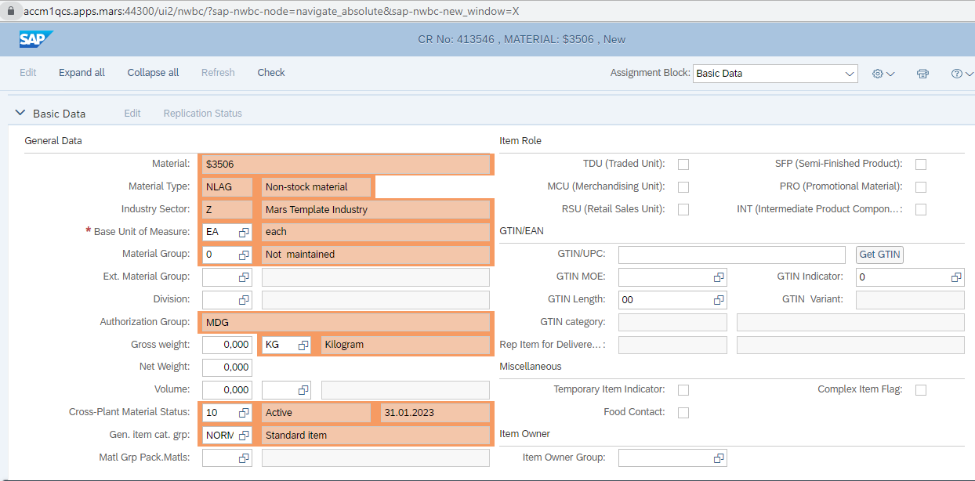
NLAG Creation
Basic Data

Slide 3
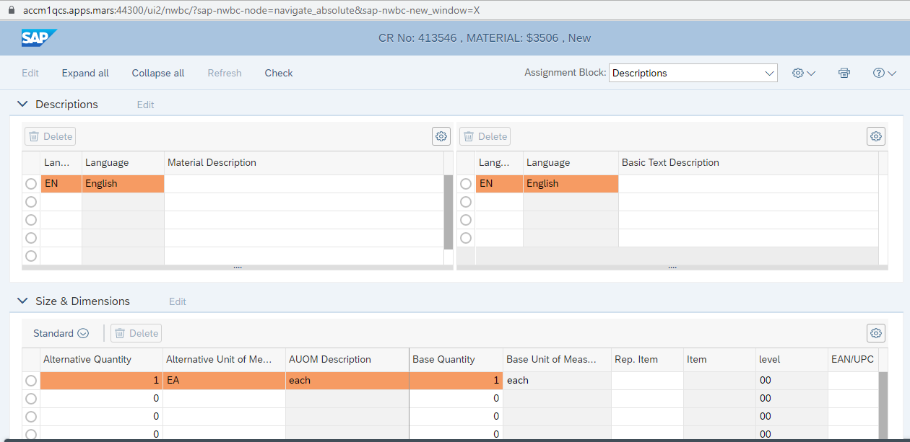
Descriptions and Size & Dimensions

Slide 4
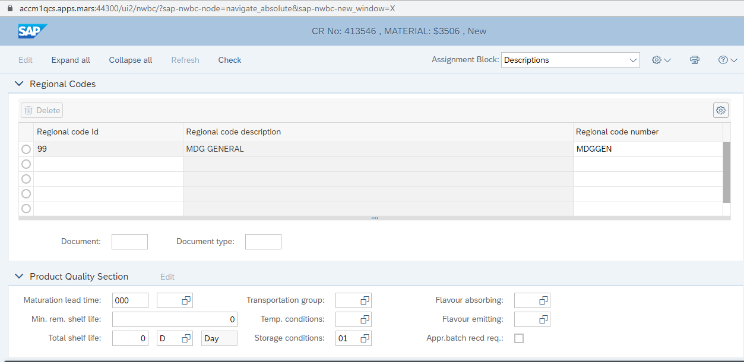
Regional codes

Slide 5

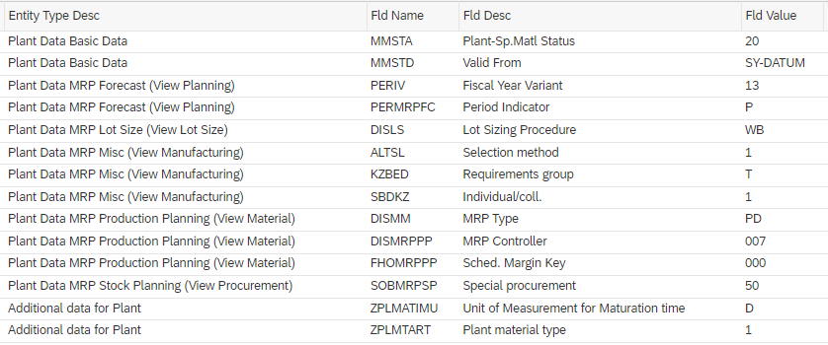

NLAG Materials – Plant Extension Global Scenario rules
This recommendation is built based on the study done for PNE factories.
MRP 1-4 and Plant Data 1-2 Views will be opened for all. QM view will be opened only with NLAG POMT 7 NAKE Scenario. (Quality team using for annual recipe checks).
They won’t be extended to Warehouses and Storage Locations.
NLAG POMT1 Pack Phantom (PALE)
NLAG POMT4 Sub recipe (SREC)
NLAG POMT7 NAKE
To be set by Plant (007 for PNE)
1 4 7

Slide 6
Material Types to be reviewed for Global Scenario creation for General and/or Plant & Sales Org Data creations

Slide 7
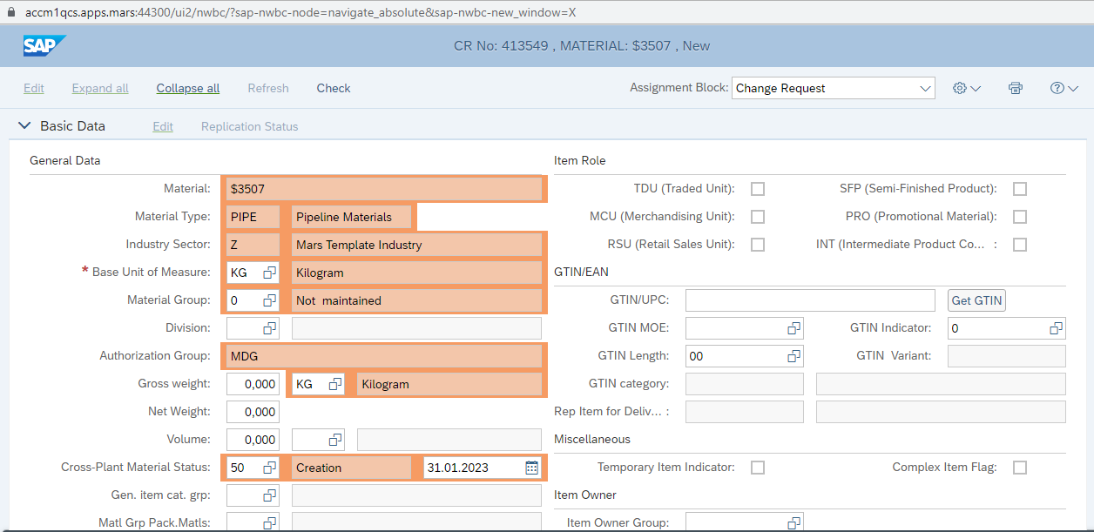
PIPE Creation
Basic Data

Slide 8

Descriptions and Size & Dimensions

Slide 9
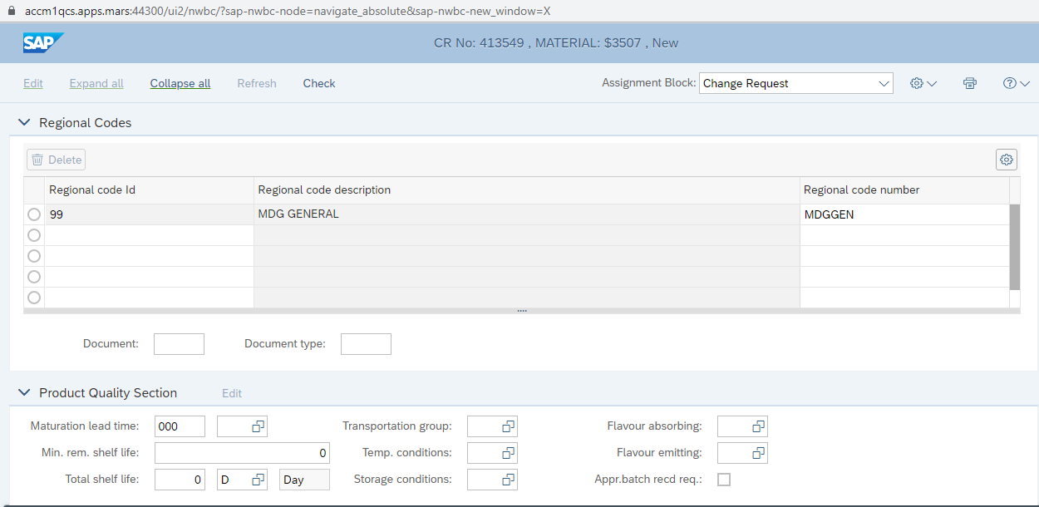
Regional codes

Slide 10
PIPE Materials – Plant Extension Global Scenario rule
For details including existing AEP & AAP extensions and comparison: PIPE plant extension rules reco_online.v2.xlsx
Yellow fields will be defaulted, Profit Center & MRP Controller will be set blank but editable. (Responsible: TBC by Cluster)
MRP 1-4 and Plant Data 1-2 Views will be opened. Storage Locations & QM Views won’t be opened.

